Slide 1
Large Scale Realistic Ocean Rendering and Simulation
Spencer McKean

Slide 2
Agenda
Background
Demo
Early Experimentations
Initial Implementations
Rendering Techniques
Results

Slide 3
Agenda
Background
Demo
Early Experimentations
Initial Implementations
Rendering Techniques
Results

Slide 4
Introduction
Background Early Experimentations Initial Implementations Performance Improvements Results
Inspired by Sea of Thieves
Large scale ocean surface simulation
Large scale interactive waves
Analyze performance impact of different portions

Slide 5
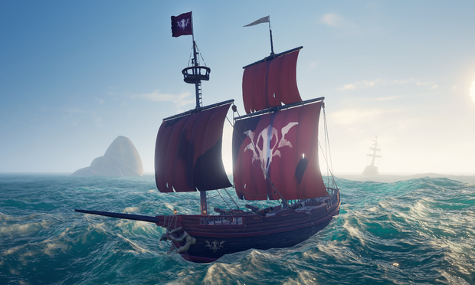
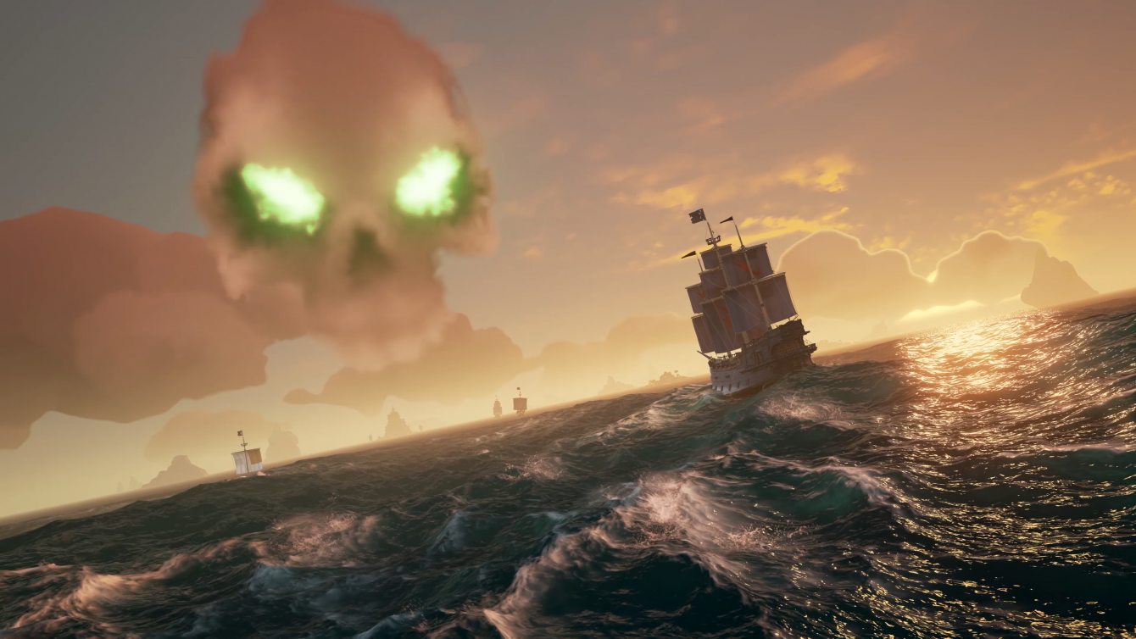
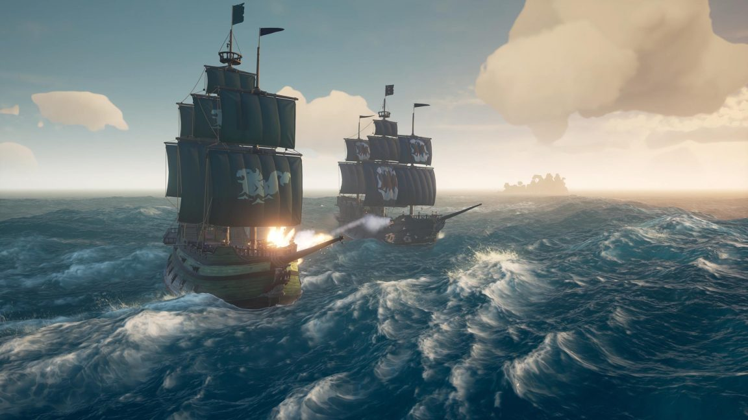
Background Early Experimentations Initial Implementations Performance Improvements Results
Figure 1: Sea of Thieves screenshot [1]
Figure 2: Sea of Thieves screenshot [2]
Figure 3: Sea of Thieves screenshot [3]

Slide 6
Demo

Slide 7
Agenda
Background
Demo
Early Experimentations
Initial Implementations
Performance Improvements
Results

Slide 8
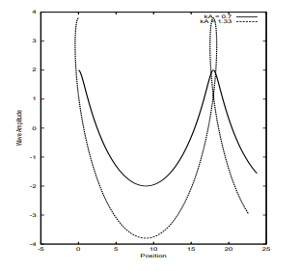
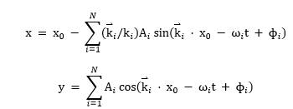
Gerstner Waves
Background Early Experimentations Initial Implementations Performance Improvements Results
Figure 5: Gerstner Wave Equations [4]
Figure 4: Potential issues with Gerstner Waves [4]

Slide 9

The Fourier Equations
Background Early Experimentations Initial Implementations Performance Improvements Results
$$h\left(\overset{⃑}{x},t\right)=\sum_{\overset{⃑}{k}}{\tilde{h}(\overset{⃑}{k},t)}e^{i\overset{⃑}{k}∙\overset{⃑}{x}}$$
$$\tilde{h}\left(\overset{⃑}{k},t\right)= {\tilde{h}}_{0}\left(\overset{⃑}{k}\right)e^{iω\left(k\right)t}+{\tilde{h}}_{0}^{∗}(−\overset{⃑}{k})e^{−iω\left(k\right)t}$$
$${\tilde{h}}_{0}(\overset{⃑}{k})=\frac{1}{\sqrt{2}}\left(ξ_{r}+{iξ}_{i}\right)\sqrt{P_{h}(\overset{⃑}{k})}$$
$$P_{h}(\overset{⃑}{k}) = A\frac{e^{−1/{(kL)}^{2}}}{k^{4}}{\left|\hat{k}∙\hat{ω}\right|}^{2}$$

Slide 10



The Phillips Spectrum
Background Early Experimentations Initial Implementations Performance Improvements Results
$$P_{h}(\overset{⃑}{k}) =A\frac{e^{−1/{(kL)}^{2}}}{k^{4}}{\left|\hat{k}∙\hat{ω}\right|}^{2}$$
$k=$Wave Vector
$k$ = $\left|\overset{⃑}{k}\right|$
$L$= $\frac{V^{2}}{g}$
$V$= Wind Speed
$g$= Gravitational Constant
$\hat{ω}$ = Wind Direction
$A$ = Global Wave Amplitude
Wave Suppression
$$e^{−k^{2}ℓ^{2}}$$

Slide 11
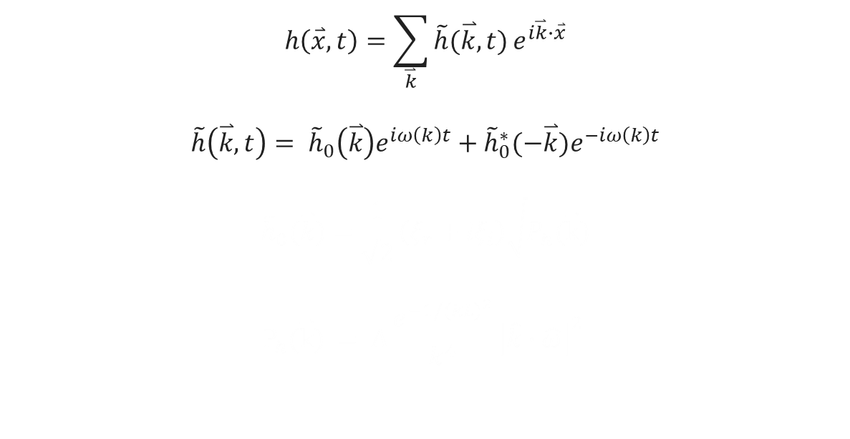
The Fourier Equations
Background Early Experimentations Initial Implementations Performance Improvements Results
$$h\left(\overset{⃑}{x},t\right)=\sum_{\overset{⃑}{k}}{\tilde{h}(\overset{⃑}{k},t)}e^{i\overset{⃑}{k}∙\overset{⃑}{x}}$$
$$\tilde{h}\left(\overset{⃑}{k},t\right)= {\tilde{h}}_{0}\left(\overset{⃑}{k}\right)e^{iω\left(k\right)t}+{\tilde{h}}_{0}^{∗}(−\overset{⃑}{k})e^{−iω\left(k\right)t}$$
$${\tilde{h}}_{0}(\overset{⃑}{k})=\frac{1}{\sqrt{2}}\left(ξ_{r}+{iξ}_{i}\right)\sqrt{P_{h}(\overset{⃑}{k})}$$
$$P_{h}(\overset{⃑}{k}) = A\frac{e^{−1/{(kL)}^{2}}}{k^{4}}{\left|\hat{k}∙\hat{ω}\right|}^{2}$$

Slide 12


Fourier Amplitudes
Background Early Experimentations Initial Implementations Performance Improvements Results
$${\tilde{h}}_{0}(\overset{⃑}{k})=\frac{1}{\sqrt{2}}\left(ξ_{r}+{iξ}_{i}\right)\sqrt{P_{h}(\overset{⃑}{k})}$$
$P_{h}\left(\overset{⃑}{k}\right)$ = Phillips Spectrum
$ξ_{r}+{iξ}_{i}$ = Gaussian Distributed Random Number

Slide 13
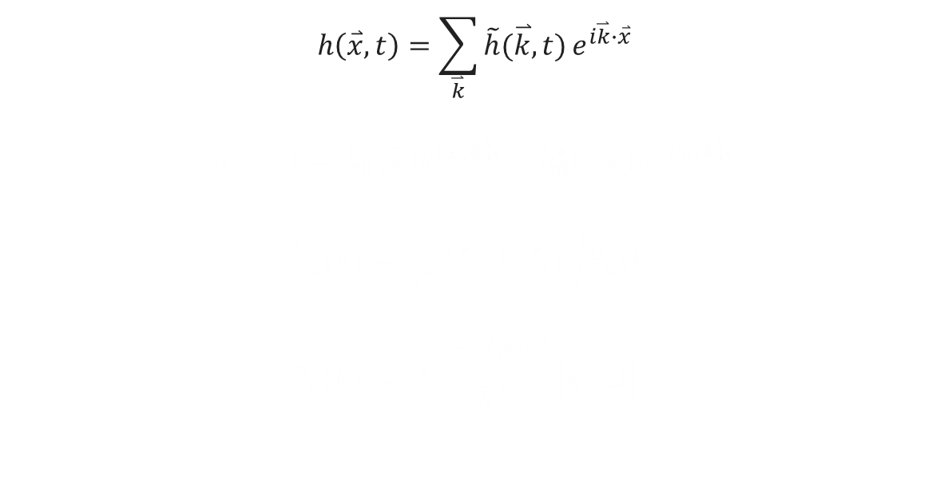
The Fourier Equations
Background Early Experimentations Initial Implementations Performance Improvements Results
$$h\left(\overset{⃑}{x},t\right)=\sum_{\overset{⃑}{k}}{\tilde{h}(\overset{⃑}{k},t)}e^{i\overset{⃑}{k}∙\overset{⃑}{x}}$$
$$\tilde{h}\left(\overset{⃑}{k},t\right)= {\tilde{h}}_{0}\left(\overset{⃑}{k}\right)e^{iω\left(k\right)t}+{\tilde{h}}_{0}^{∗}(−\overset{⃑}{k})e^{−iω\left(k\right)t}$$
$${\tilde{h}}_{0}(\overset{⃑}{k})=\frac{1}{\sqrt{2}}\left(ξ_{r}+{iξ}_{i}\right)\sqrt{P_{h}(\overset{⃑}{k})}$$
$$P_{h}(\overset{⃑}{k}) = A\frac{e^{−1/{(kL)}^{2}}}{k^{4}}{\left|\hat{k}∙\hat{ω}\right|}^{2}$$

Slide 14


Fourier Amplitudes at Time
Background Early Experimentations Initial Implementations Performance Improvements Results
$$\tilde{h}\left(\overset{⃑}{k},t\right)= {\tilde{h}}_{0}\left(\overset{⃑}{k}\right)e^{iω\left(k\right)t}+{\tilde{h}}_{0}^{∗}(−\overset{⃑}{k})e^{−iω\left(k\right)t}$$
$ω\left(k\right)$ = Dispersion Relation
${\tilde{h}}_{0}\left(\overset{⃑}{k}\right)$ = Fourier Amplitude
${\tilde{h}}_{0}^{∗}(−\overset{⃑}{k})$ = Fourier Amplitude Conjugate

Slide 15
The Fourier Equations
Background Early Experimentations Initial Implementations Performance Improvements Results
$$h\left(\overset{⃑}{x},t\right)=\sum_{\overset{⃑}{k}}{\tilde{h}(\overset{⃑}{k},t)}e^{i\overset{⃑}{k}∙\overset{⃑}{x}}$$
$$\tilde{h}\left(\overset{⃑}{k},t\right)= {\tilde{h}}_{0}\left(\overset{⃑}{k}\right)e^{iω\left(k\right)t}+{\tilde{h}}_{0}^{∗}(−\overset{⃑}{k})e^{−iω\left(k\right)t}$$
$${\tilde{h}}_{0}(\overset{⃑}{k})=\frac{1}{\sqrt{2}}\left(ξ_{r}+{iξ}_{i}\right)\sqrt{P_{h}(\overset{⃑}{k})}$$
$$P_{h}(\overset{⃑}{k}) = A\frac{e^{−1/{(kL)}^{2}}}{k^{4}}{\left|\hat{k}∙\hat{ω}\right|}^{2}$$

Slide 16


The Fourier Equation
Background Early Experimentations Initial Implementations Performance Improvements Results
$$h\left(\overset{⃑}{x},t\right)=\sum_{\overset{⃑}{k}}{\tilde{h}(\overset{⃑}{k},t)}e^{i\overset{⃑}{k}∙\overset{⃑}{x}}$$
$\tilde{h}(\overset{⃑}{k},t)$ = Fourier Amplitudes at Time

Slide 17
The Fourier Equations
Background Early Experimentations Initial Implementations Performance Improvements Results
$$h\left(\overset{⃑}{x},t\right)=\sum_{\overset{⃑}{k}}{\tilde{h}(\overset{⃑}{k},t)}e^{i\overset{⃑}{k}∙\overset{⃑}{x}}$$
$$\tilde{h}\left(\overset{⃑}{k},t\right)= {\tilde{h}}_{0}\left(\overset{⃑}{k}\right)e^{iω\left(k\right)t}+{\tilde{h}}_{0}^{∗}(−\overset{⃑}{k})e^{−iω\left(k\right)t}$$
$${\tilde{h}}_{0}(\overset{⃑}{k})=\frac{1}{\sqrt{2}}\left(ξ_{r}+{iξ}_{i}\right)\sqrt{P_{h}(\overset{⃑}{k})}$$
$$P_{h}(\overset{⃑}{k}) = A\frac{e^{−1/{(kL)}^{2}}}{k^{4}}{\left|\hat{k}∙\hat{ω}\right|}^{2}$$

Slide 18
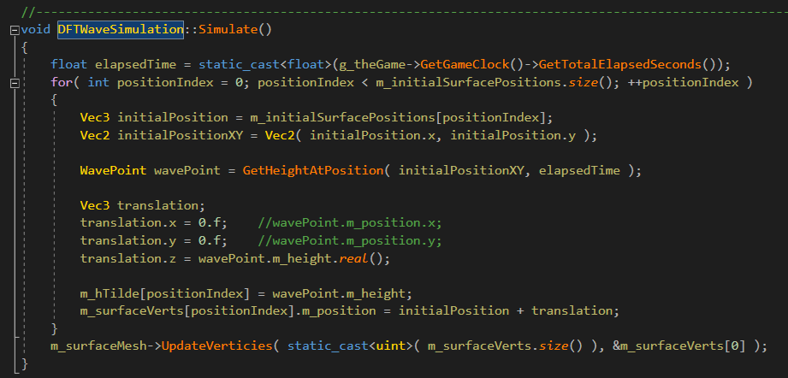
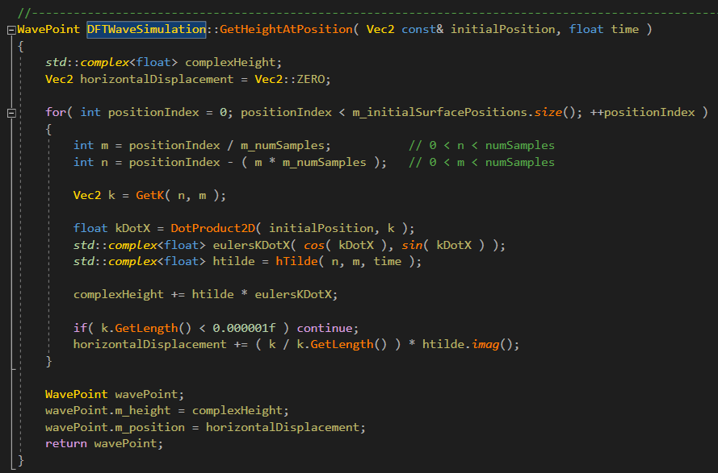
Discrete Fourier Transform (DFT) Waves
Background Early Experimentations Initial Implementations Performance Improvements Results
Figure 6: Implementation of DFT Waves
Figure 7: Implementation of DFT Waves

Slide 19
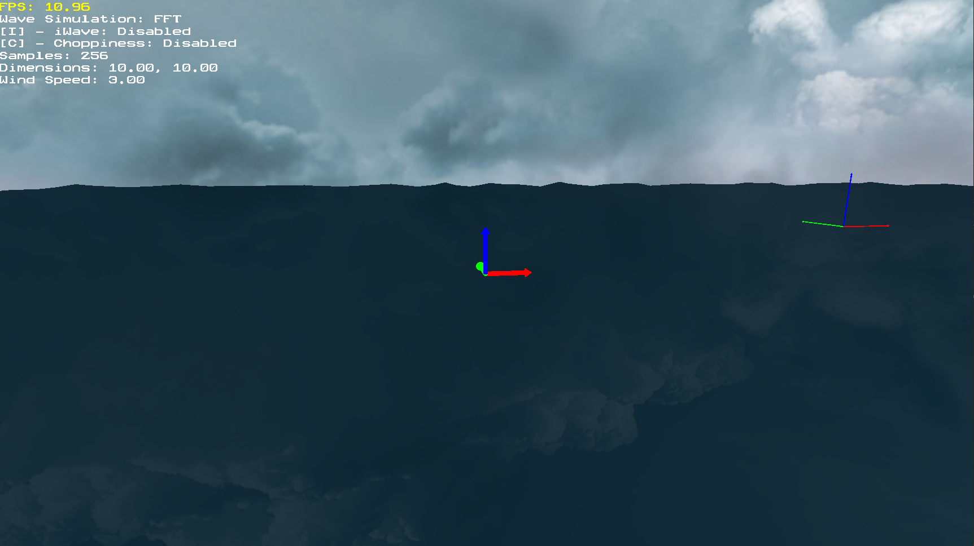
Discrete Fourier Transform Waves
Background Early Experimentations Initial Implementations Performance Improvements Results
Figure 8: Implementation of DFT Waves

Slide 20
Agenda
Background
Demo
Early Experimentations
Initial Implementations
Rendering Techniques
Results

Slide 21
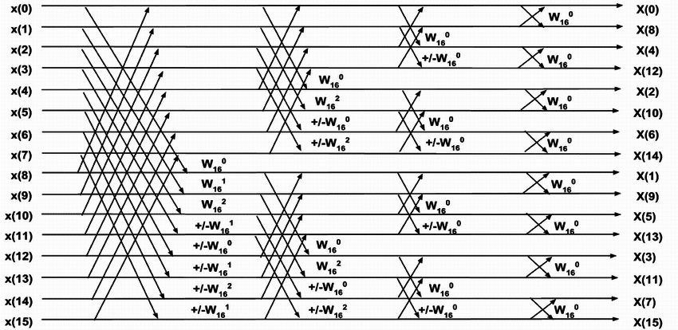
FFT
Background Early Experimentations Initial Implementations Performance Improvements Results
Figure 1: Sea of Thieves screenshot [1]
Figure 9: Butterfly Algorithm [5]

Slide 22
Agenda
Background
Demo
Early Experimentations
Initial Implementations
Rendering Techniques
Results

Slide 23
Rendering Techniques
Background Early Experimentations Initial Implementations Performance Improvements Results
Scrolling normals
Refraction and Snell’s Law
Lighting

Slide 24
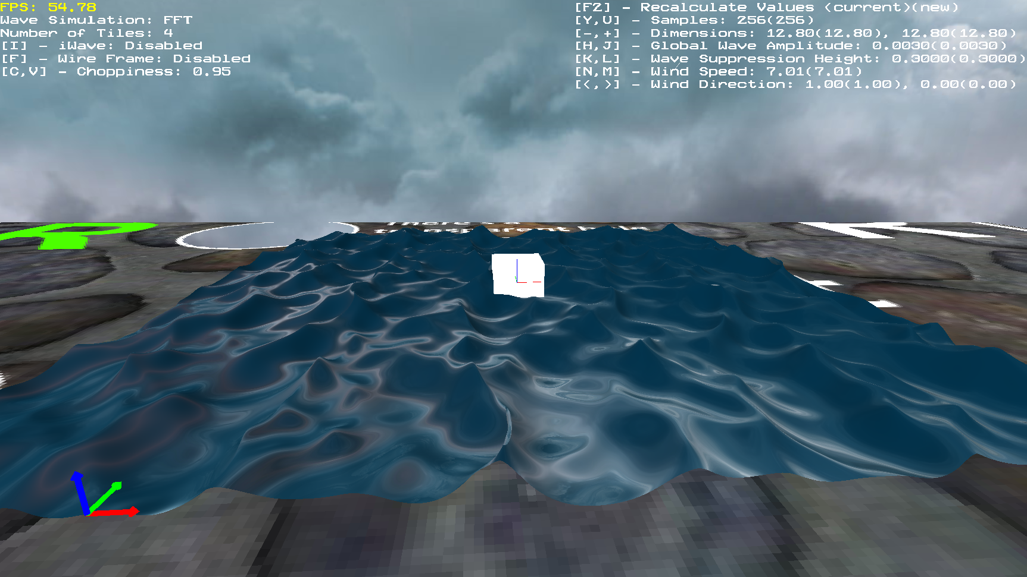
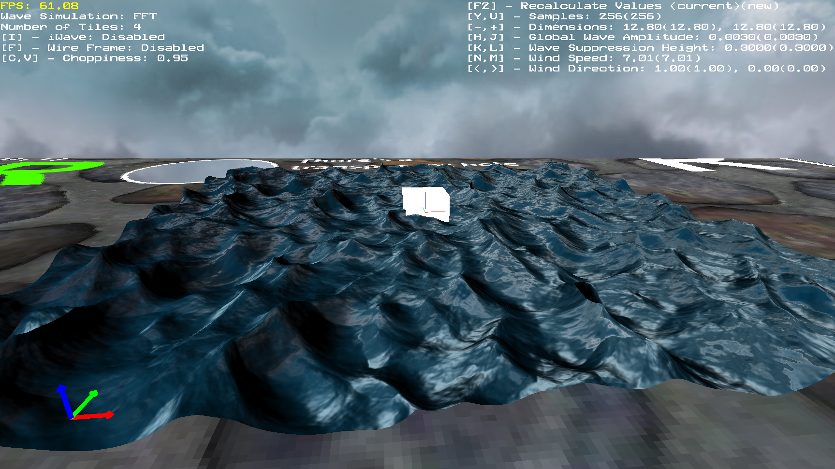
Scrolling Normals
Background Early Experimentations Initial Implementations Performance Improvements Results
Figure 10: Water without scrolling normals
Figure 11: Water with scrolling normals

Slide 25
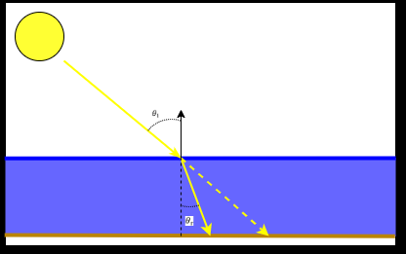

Refraction and Snell’s Law
Background Early Experimentations Initial Implementations Performance Improvements Results
Snell’s Law
$$n_{1}\sin{θ_{i} }=n_{2}\sin{θ_{r}}$$
$n_{1}$ = Incident Refractive Index
$n_{2}$ = Refracted Refractive Index
$θ_{i}$ = Angle of Incidence
$θ_{r}$ = Refracted Angle
Figure 12: Snell’s Law

Slide 26
Screen Space Raytracing
Background Early Experimentations Initial Implementations Performance Improvements Results
Blah
Blah
Blah
Didn’t work, same problem.

Slide 27
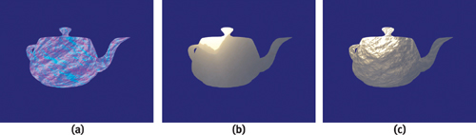
Perturbations
Background Early Experimentations Initial Implementations Performance Improvements Results
Offset based on normal
Normals changing from simulation
Although inaccurate, decent results
Easily avoids the problem of sampling outside the backbuffer
Figure 13: Perturbation Texture Sampling [6]

Slide 28
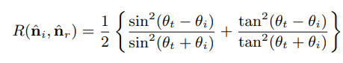


Lighting
Background Early Experimentations Initial Implementations Performance Improvements Results
Fresnel Reflectivity and Transmissivity
$$R + T = 1$$
$$Reflected Color = R ∗ Reflection Sample$$
$$Transmitted Color = T ∗ Floor Sample$$
$$Water Surface Color =$$
$$Reflected Color + Transmitted Color + Specular Highlight$$

Slide 29
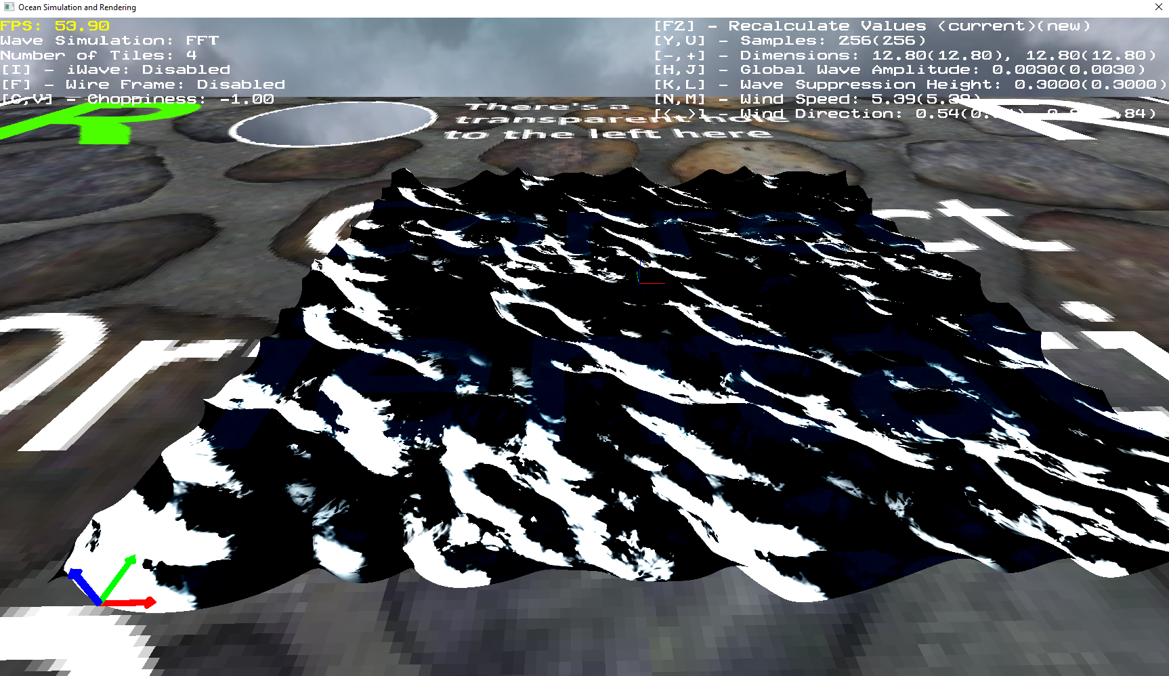
Refraction and Snell’s Law
Background Early Experimentations Initial Implementations Performance Improvements Results

Slide 30
Performance Improvements
Background Early Experimentations Initial Implementations Performance Improvements Results
Wave vertex data structure
Threaded FFT
Compute Shader FFT

Slide 31
Agenda
Background
Demo
Early Experimentations
Initial Implementations
Rendering Techniques
Results

Slide 32
Preliminary Results
Background Early Experimentations Initial Implementations Performance Improvements Results
DFT not manageable at interactive speeds
FFT on one thread at a low number of samples
iWave impacts performance

Slide 33
Background Early Experimentations Initial Implementations Performance Improvements Results

Slide 34
Background Early Experimentations Initial Implementations Performance Improvements Results

Slide 35
References
Background Early Experimentations Initial Implementations Performance Improvements Results
[1] | K. Stuart, "Sea of Thieves: How Rare Silenced the Cannons and Brought Peace to the Seas," 18 July 2018. [Online]. Available: https://www.theguardian.com/games/2018/jul/18/sea-of-thieves-rare-games-update-the-hungering-deep-cursed-sails-forsaken-shores. [Accessed 19 July 2020].
[2] | M. Ruiz, "Sea of Thieves Review — A Whole Lot of Booty," 29 March 2018. [Online]. Available: https://www.dualshockers.com/sea-of-thieves-review-xbox-one/. [Accessed 19 July 2020].
[3] | M. Martin, "Sea of Thieves Reviews Round-up – All the Scores for Rare’s Wonky Pirate Adventure," 22 March 2018. [Online]. Available: https://www.vg247.com/2018/03/22/sea-of-thieves-reviews-scores/. [Accessed 19 July 2020].
[4] | J. Tessendorf, "Simulating Ocean Water," 2004. [Online]. Available: https://people.cs.clemson.edu/~jtessen/reports/papers_files/coursenotes2004.pdf.

